Slide 1
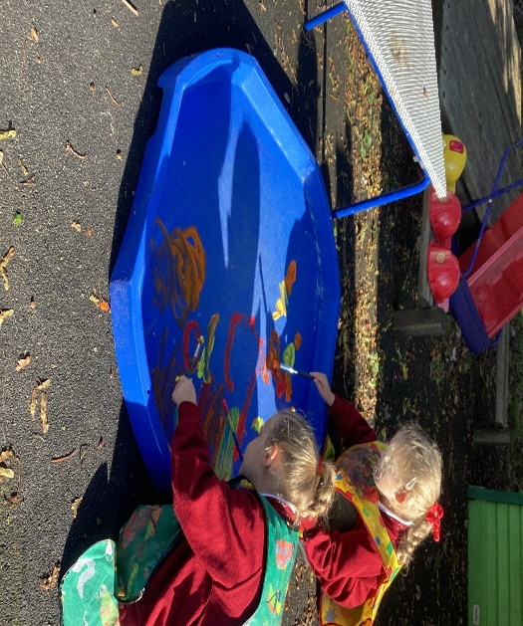
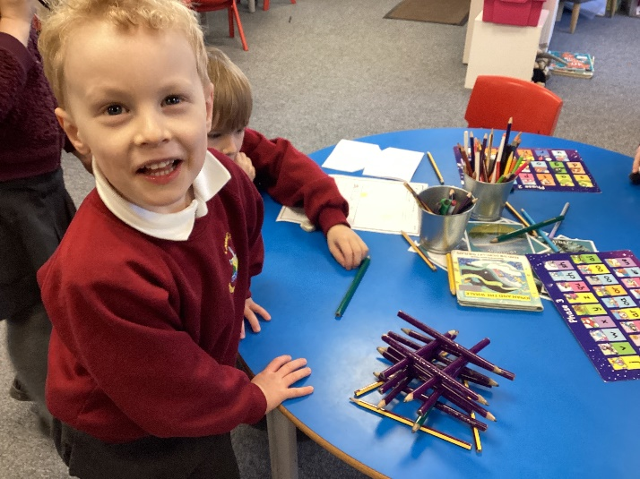
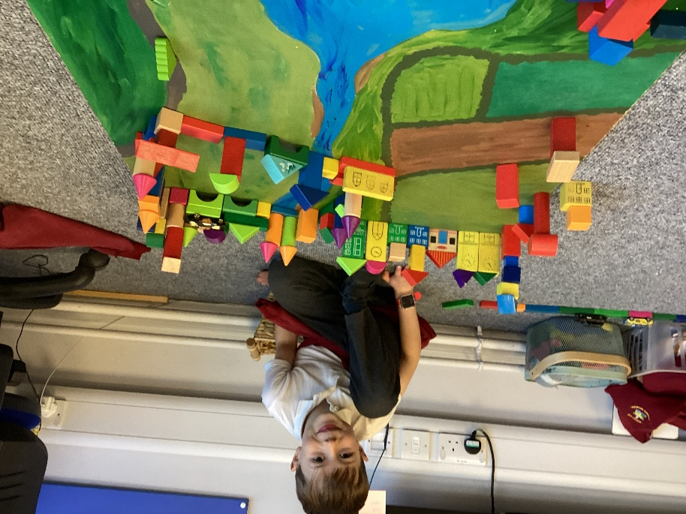
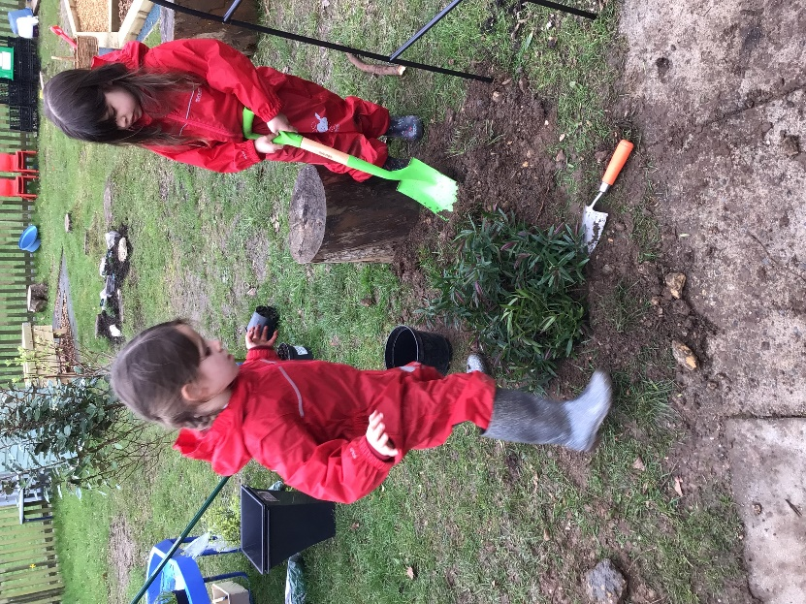
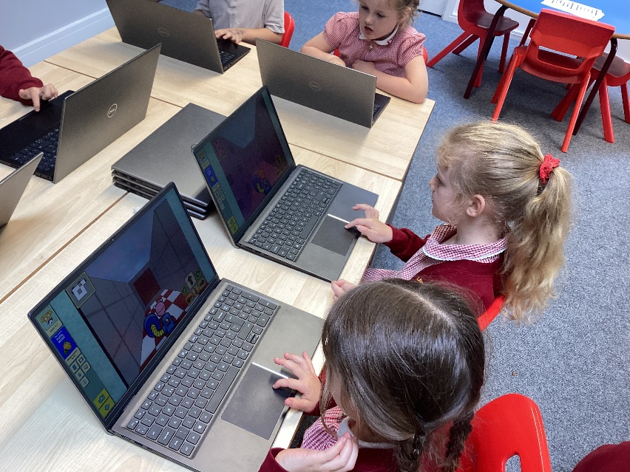
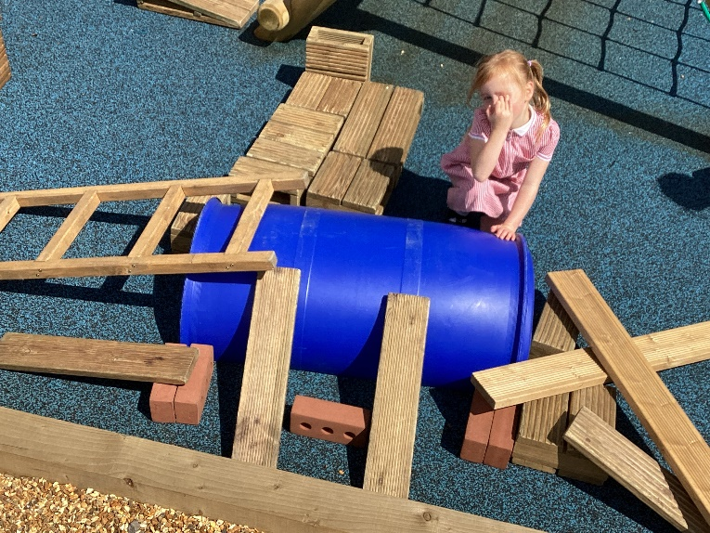
Welcome to Wren Class
Always aiming for our best

Slide 2
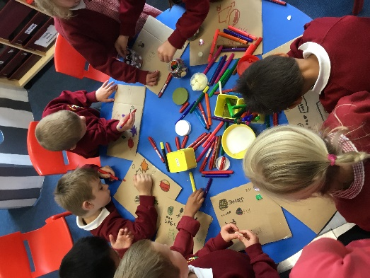
What will it be like in Reception?
Readiness is the key
Lots of play
Lots of talking and listening and asking and answering questions.
Fine motor skills development – develop strength in muscles of fingers.
Daily phonics and maths input.
Planning linked to the curriculum and children's interests.
All children read every day as part of phonics sessions.
Guided reading will begin when children are ready.

Slide 3
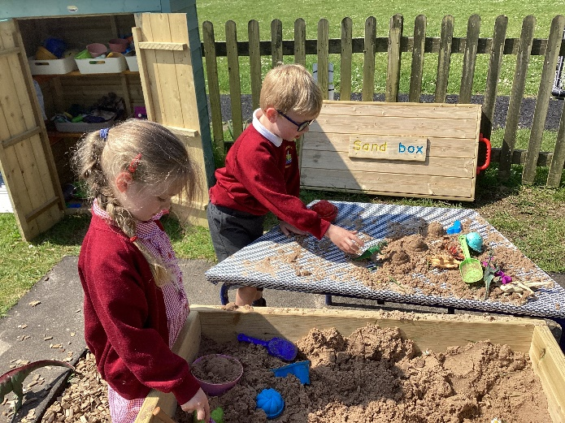
Expectations
First few weeks will be spent settling in, setting expectations, creating a whole class ethos and culture. Positive relationships are at the heart of learning.
We are a nurturing school. We really encourage children to have a go, aim for their best and learn from their mistakes.
We want the children to take risks, be curious and ask questions – to be active learners.
There will be lots of talking and playing with the children to get to know them.
Everything we do is underpinned by our school Christian values.

Slide 4
The Classroom
Key areas reflecting all areas of the curriculum are set up inside and out and are changed to reflect the current learning focus. These include; Construction, Investigation, Reading Corner, Writing area, Maths area, Music, Painting, Drawing / Chalking, investigating, Role Play, Sand, Water, Mud Kitchen, Bikes.
Language rich environment – Print for purpose, Learning Wall where we gather key vocabulary, use of high quality texts.
Lots of floor space for children to spread out.
Quality resources to enhance learning, organised to promote independence and keep the environment fresh and interesting.
Changed to enhance the needs and interests of the children.

Slide 5
The Curriculum
We run a 2 year cycle of learning which gives a foundation level of knowledge and skills which will then be built on in Key Stage 1.
It covers all the areas of the EYFS framework and Development matters.
It allows for core skills to be developed and also for knowledge to be acquired. We are ambitious in our expectations and provide a wide range of learning experiences and opportunities for children to show their understanding.
It is flexible; we have a framework which allows us to build in the children’s interests and ideas as well.

Slide 6
Settling into school.
Familiarisation visits to Wren Class for new Reception children:
Wednesday 3rd July1:15 – 2:45pm. Parents may join us or wait in the hall.
Tuesday 16th July 9:15– 10:45am. If parents could drop their children off please.
First day at school: Tuesday 2nd September. 8:45 – 11:50am.
Then from Tuesday 2nd – Friday 5th September 8:45 11:50am
From Monday 8th September, all children can come full time if you wish (8.45 – 3.15pm). Once they are full time we can’t then reverse it to part time. If they are very tired it is possible to arrange collection at 1pm on a Thursday and Friday. Please talk to me about it during the week.

Slide 7
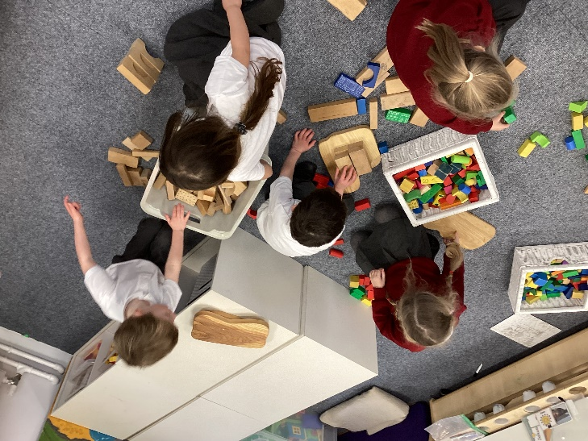
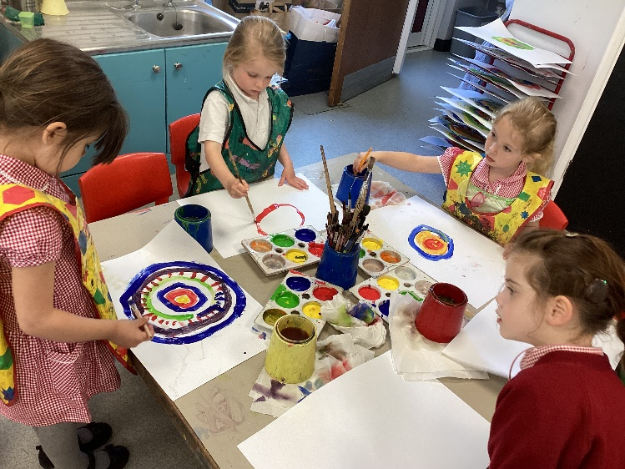
Parent Partnership
We want you to be as involved as possible this year.
You are your child's first educator and you know them best. Please share with us on Seesaw milestones and key knowledge and skills that your child demonstrates at home. Sharing experiences from home also help the children to get to know each other and to be able to talk about life outside of the classroom
Reading at home is so important, children will bring home books from week 2.
Children will bring home phonics following the day's session during the first term. Please practice each letter sound with them. I will post videos on SeeSaw to support with phonic pronunciation. In Spring and Summer they will bring home a support sheet each week.
Homework – activities which will support/enrich learning in school are sent home when appropriate for them to choose from a grid.

Slide 8
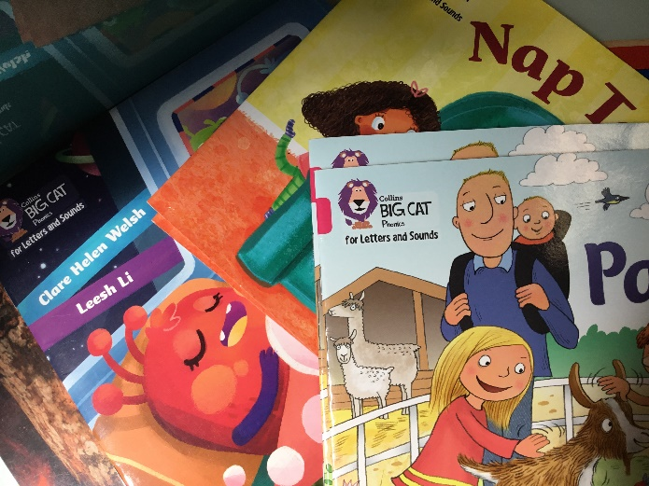
Reading Books
Children will be given a Reading Diary. Please record 4 to 5 times a week when you have read with your child. A prompt sheet will be included in the Reading Diary.
Children will change their books throughout the week on different days.
They will be given a decodable reading book which we would like them to read as independently as possible.
They will have these books for the week and they should read their decodable book as often and as many times as possible.
They will each have a little tin in which to put the ‘Rainbow words’ which they need to learn by heart.

Slide 9
What Might a day look like?
8:45am – settling in activities
9:00am – Phonics
9:30 – Maths or learning journey input followed by adult led activity. Small group work and continuous provision.
10:15 – fruit and milk and talk time
10:30 – Assembly
10:45 –Playtime
11:00 continuing of activities from before play
12:00 - 1:00pm – Lunchtime – 30 mins in lunch hall and 30 minutes playtime.
1 – 2:45pm Learning Journey input followed by continuous provision and adult led activity. *
2:45 – 15 minutes of fitness
3:00 – Story
3:15 Hometime
* During the afternoons an adult will also read with the children.

Slide 10
House keeping
Name everything – biro or sewn in labels are the best.
Please provide a pair of named wellies to keep in school.
Please make sure their book bag and books come into school each day. While we plan to read with them at certain times each week, we also grab every small opportunity to do this as regularly as we can. Book bags also allow us to send home letters and homework without it getting lost.
Please send your child into school each Wednesday in our school PE kit.
We provide (courtesy of The Friends) a water bottle for your child. You can replace it (The whole thing or just the lid) whenever you wish from the school office. The children will bring it home daily for washing and refilling.
Children have their own drawer to put their book bag and jumper in.
Each morning all children will be offered fruit and milk. Once 5 yrs old you need to pay if your child would still like milk. Water bottles are always available.

Slide 11
SeeSaw
Log in details will be sent to you in the first few weeks of term.
You can then download the app and log in.
We will post phonics videos so you can learn the sounds and sometimes maths videos so you know the approach we’re taking.
You will be able to see some of your child's learning throughout the year.
It can be a way of communicating with us too.
You can also send an email to:
wrenclass@lavant.w-sussex.sch.uk

Slide 12
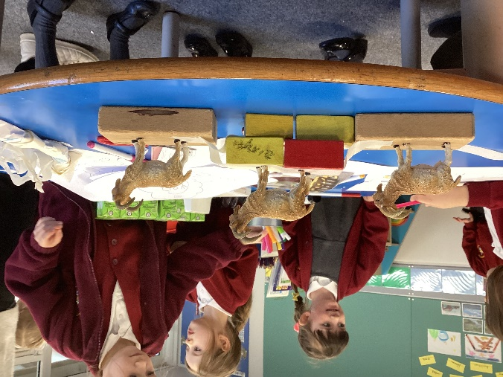
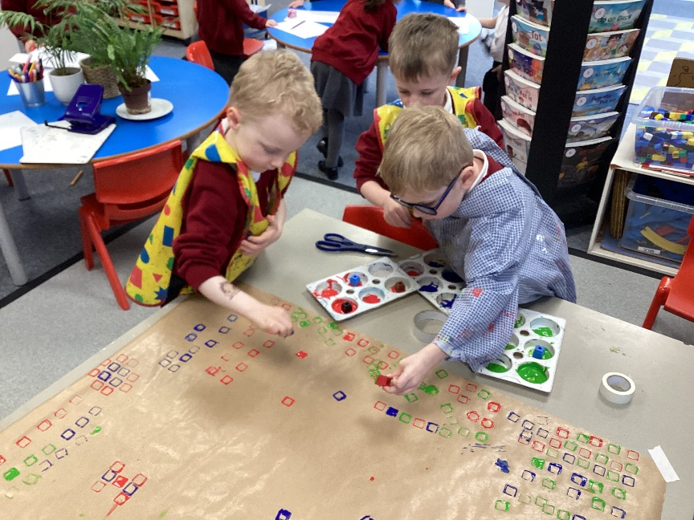
Thank you for choosing Lavant :)
We very much look forward to getting to know you and your child.
This year we will be working in small groups and running a 2 week timetable with an alternate focus on either Maths or Learning Journey each day. The children will also have continuous provision which will develop their skills and understanding of our learning focus.
We are looking forward to some exciting adventures in learning.

