Slide 1
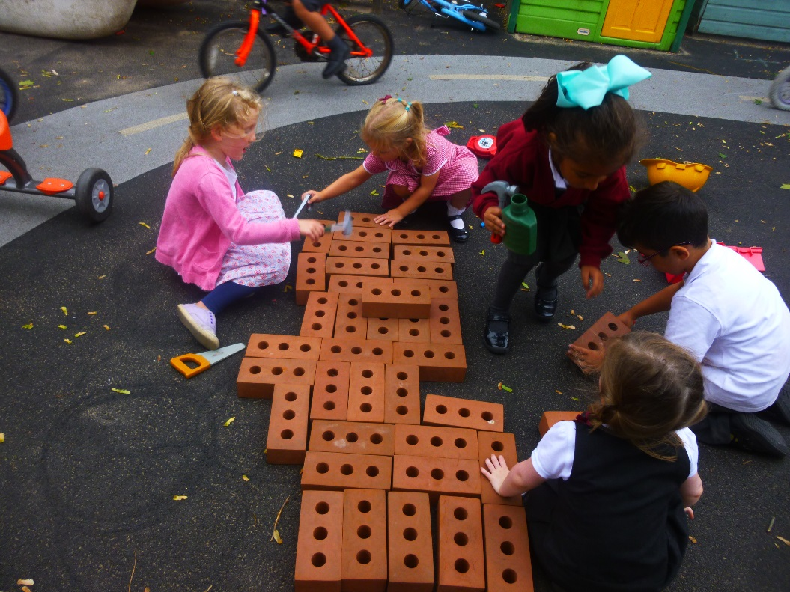
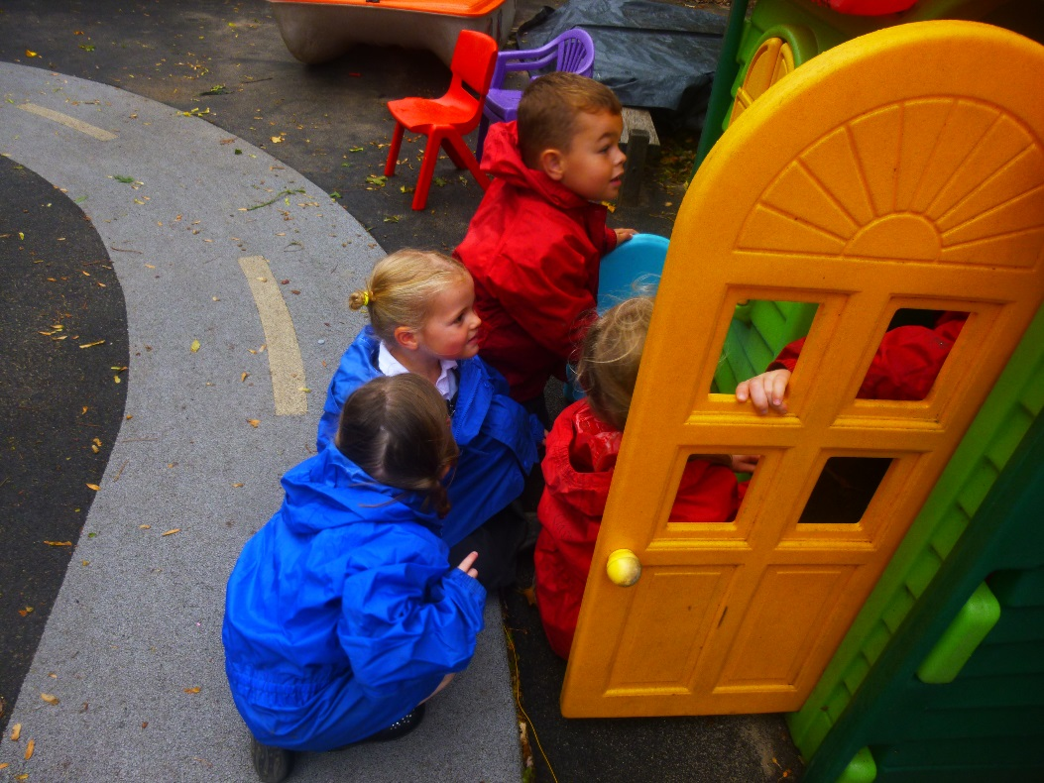
Welcome to our Breakfast Meeting

Slide 2
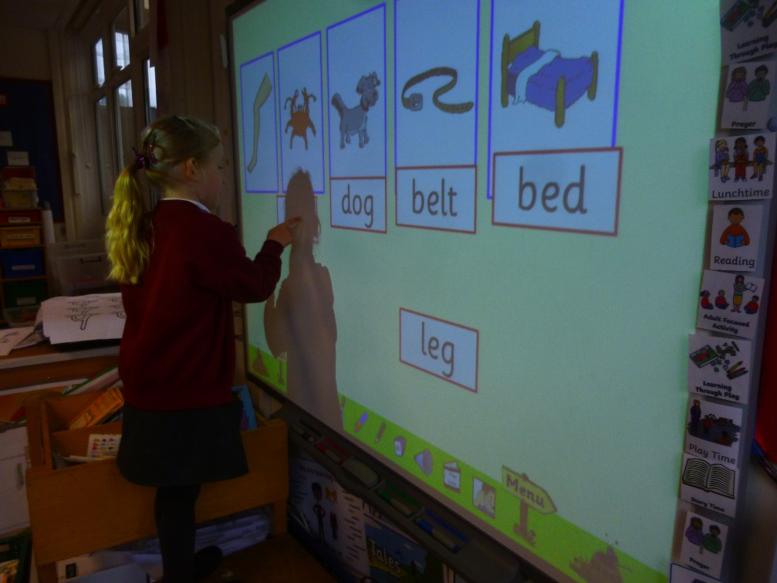
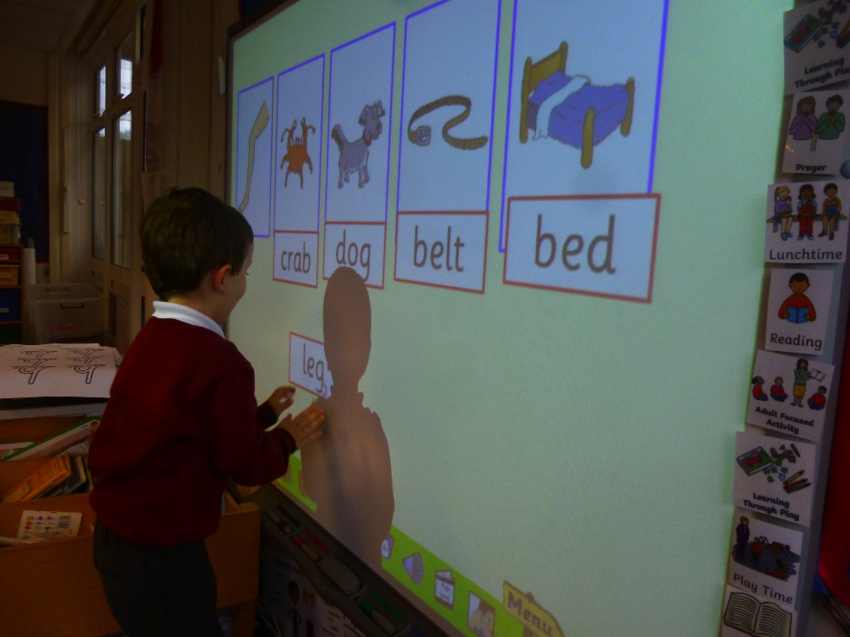
Jolly Phonics
A multisensory experience for the children, very interactive and fun
Fast paced- we cover a letter a day until we reach ‘er’, then revisit
Handwriting practice sheets come home on a daily basis for you to reinforce what we do at school and again on Friday we revise the letters we have learnt that week.

Slide 3
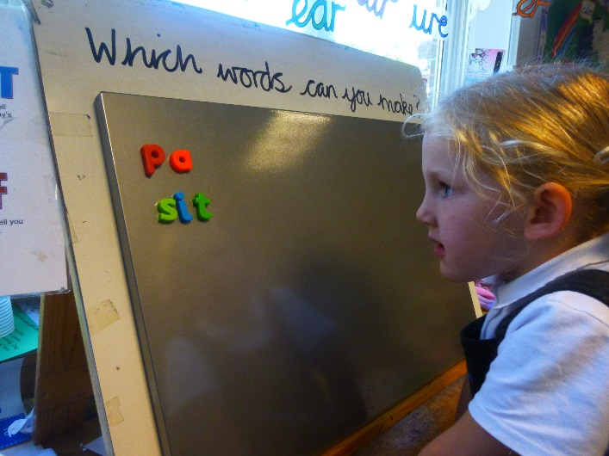
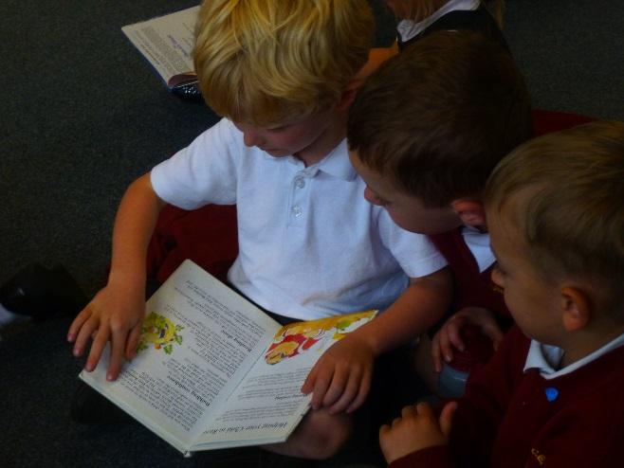
Reading
Jolly Phonics plays a key role
Reading Scheme- The Oxford Reading Tree after half term- get to know names of characters and bring home story books- with or without words
Can’t emphasise enough the importance of children being able to talk about a story, and tell the story in their own words because they are so familiar with it. To be able to talk about the characters and settings.
Don’t worry if your child brings home books without words – These are really important in helping the children to develop the ability to tell stories

Slide 4
Developing Writing Skills: Independent writing
It’s important to remember that the children are all at different stages in their development.
Independent writing
We teach them that they are the boss of their writing We talk about why we write. When do we see others write?
We discuss what writing looks like - circular movements and straight lines, letter like shapes, letters representing key sounds in words in the order that they hear them.
We provide many opportunities for them to write and make marks; white boards, chalk boards, clip boards, chalk, writing aprons, well stocked writing corner etc
The children learn from us all and gradually gain in confidence and independence, becoming more confident to have a go.

Slide 5
Developing Writing Skills: Letter formation
As part of our Phonics sessions we focus on letter formation which is something the children need to get right very early on, when they are ready to write - in order to get into good writing habits. One of the ways we do this is during our phonics sessions where we repeatedly practice (in a multi sensory way) the letter of the day – as many of you saw yesterday.
Pre-writing skills: Really important for those children; not holding a pen correctly or forming letters smoothly with good control. Theses children need to strengthen their fine motor skills – FINGER GYM
Name writing practice forms an important part of learning to write- however children need to be taught to write each letter in their name correctly on a 1:1 basis – hence sending home name writing practice sheets at half term ☺.

Slide 6
Developing Independent Writing Skills: Model writing
We model writing throughout the day for children giving them many opportunities to see what it is all about and how we go about it…
Use of Jolly Phonic Sound Cards – We go through a very important process when we write together in small or large groups –
say the word,
What is the first sound that you can hear?
find it on the Jolly Phonics sound card,
write it down.
Say the same word again and write down the other sounds we can hear, in the order in which they occur, following the same steps.
It can seem quite tricky to begin with which is why we don’t start with complete sentences – just individual words. We only focus on the sounds the children can hear – so it often doesn’t look like a proper word but the children rapidly begin to see themselves as writers this way. We find the letter sounds we need in pairs/small groups so it isn’t a test. We keep it short and fun with lots of praise and encouragement.

Slide 7
You are invited to a Maths Lesson on 21st November. ☺ I hope you enjoyed the Phonics lesson on 31st October ☺

Slide 8
Thank you for coming

