Slide 1
Maths at Lavant CE Primary School
February 2023

Slide 2
Maths and a Growth Mindset

Slide 3
Aims of the National Curriculum
develop fluency
be able to solve problems
reason mathematically

Slide 4
What you’ll see in our classrooms:
High expectations and appropriate level of challenge

Slide 5
Considered small-step progressions
Planning which draws on a range of high quality maths resources

Slide 6
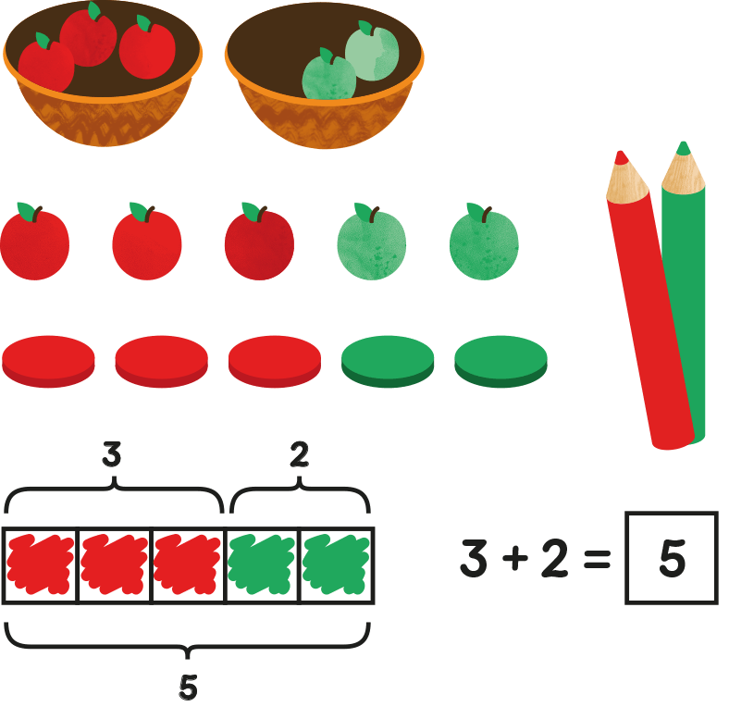
Concrete, pictoral and abstract representations
Wide range of high quality manipulatives in regular use

Slide 7
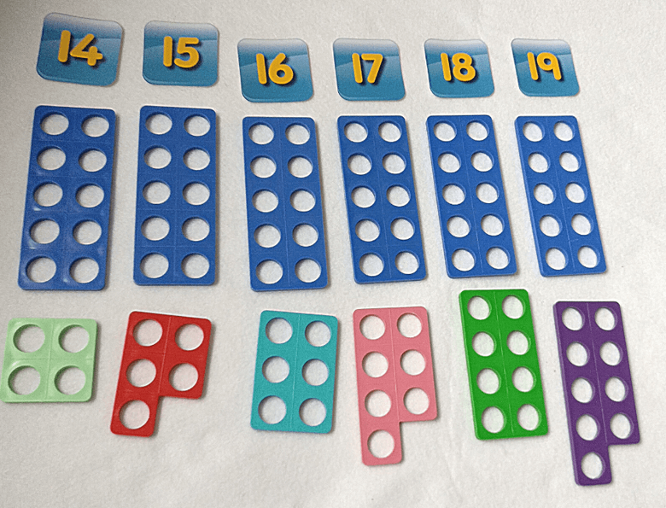
Regular fluency sessions
Regular reasoning and problem solving opportunities

Slide 8
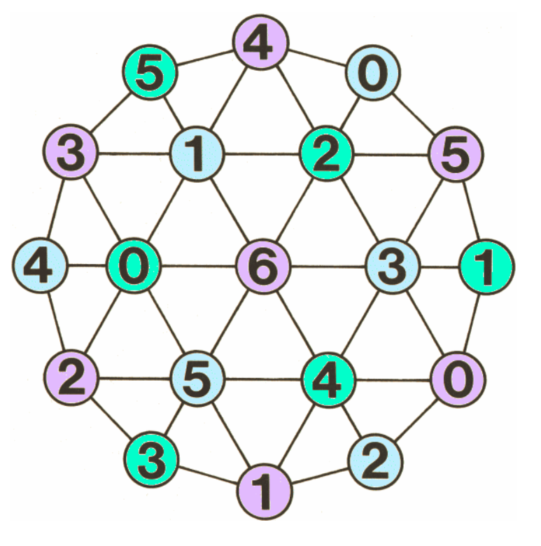
Fun, engaging tasks
LTHC Tasks

Slide 9
Displays

Slide 10
Opportunities for discussion

Slide 11
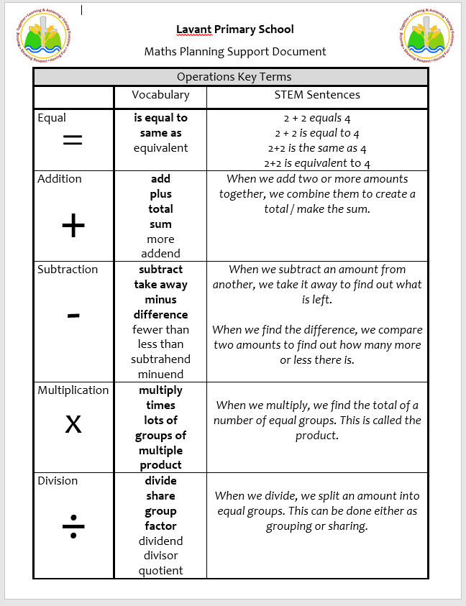

Slide 12
Calculation Policy

Slide 13
Come and see some maths in action…

