Slide 1
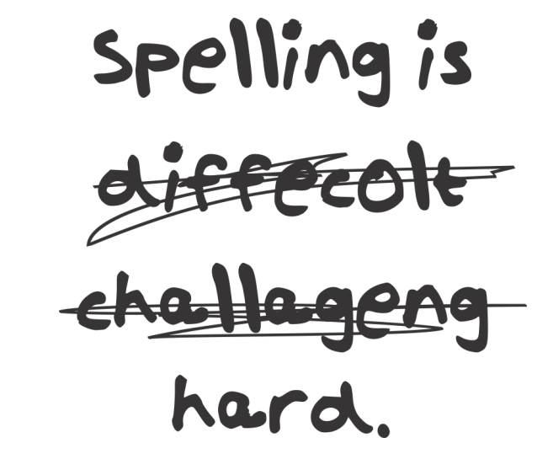
Spelling Workshop
Wednesday 7th March 2018

Slide 2
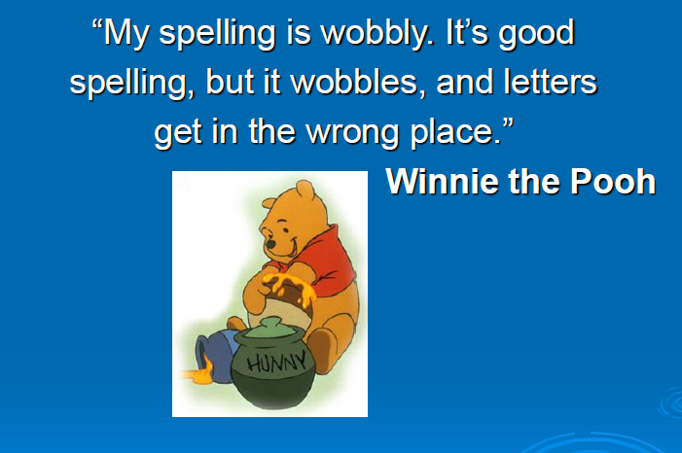

Slide 3
Eye halve a spelling checker
It came with my pea sea
It plainly marques for my revue
Miss steaks eye kin knot sea.
Eye strike a key and type a word
And weight four it to say
Weather eye am wrong oar write
It shows me strait a weigh.
As soon as a mist ache is maid
It nose bee fore two long
And eye can put the error rite
It's rare lea ever wrong.
Eye have run this poem threw it
Eye am shore your pleased two no
It's letter perfect awl the weigh
My checker tolled me sew. By Margo Roark.

Slide 4
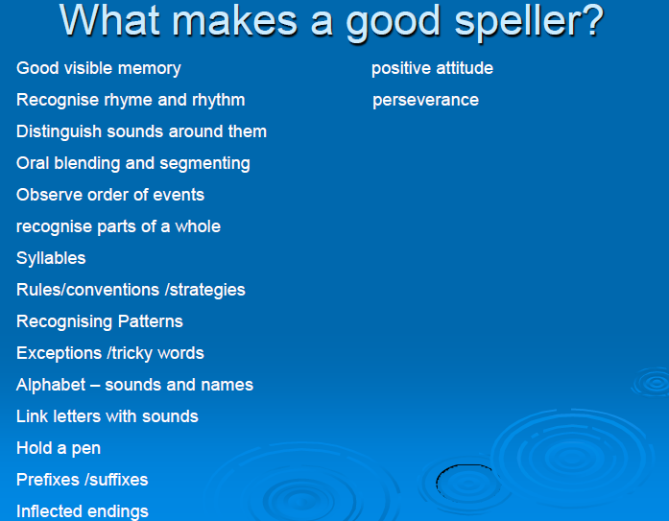

Slide 5
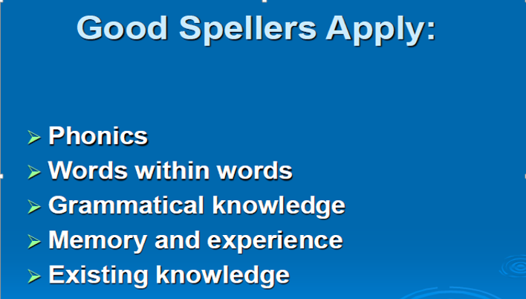

Slide 6
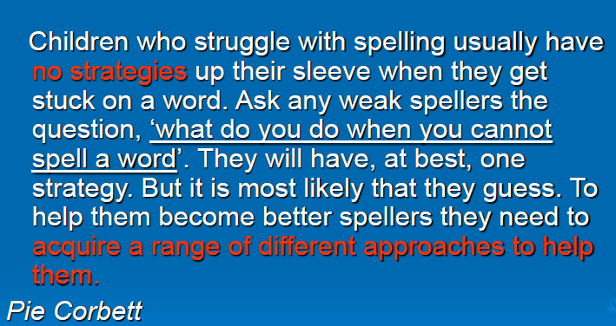

Slide 7
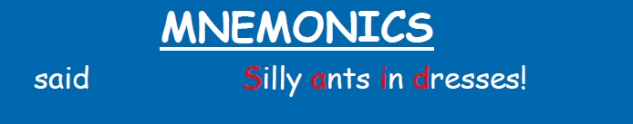
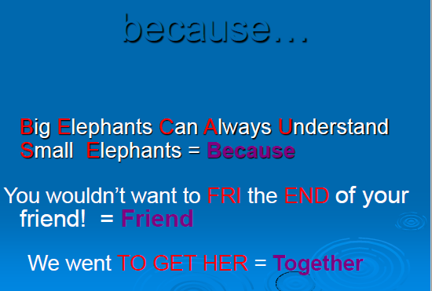

Slide 8
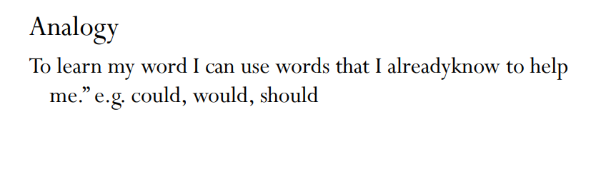

Slide 9
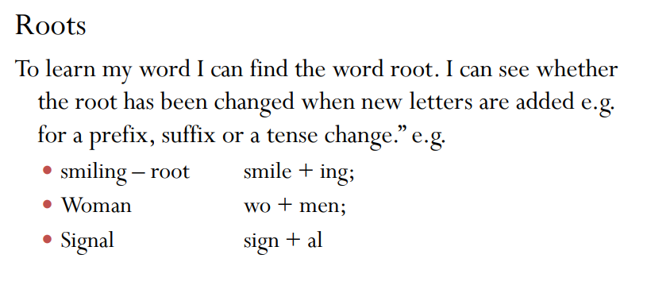

Slide 10
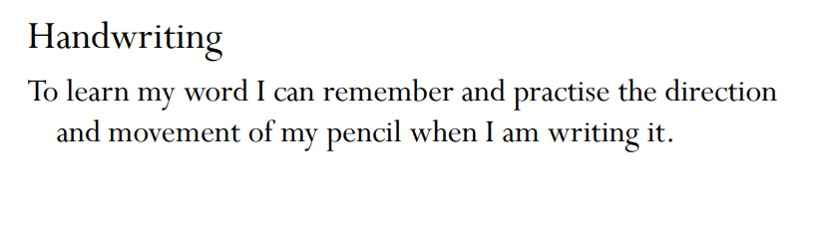

Slide 11





Slide 12
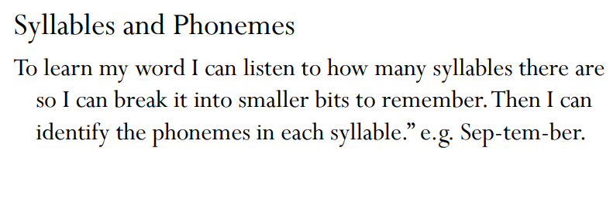

Slide 13
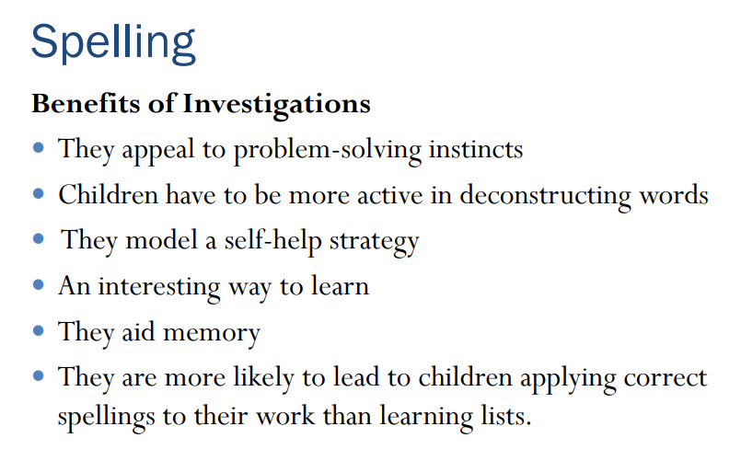

Slide 14
