Slide 1
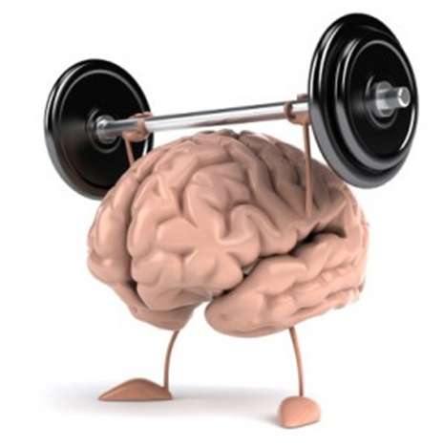
Metacognition Growth mindset

Slide 2
Learning together in faith – always aiming for the best

Slide 3
Tools for effective learning
What do we mean by mindset?
A set of beliefs that determine somebody’s behaviour and outlook in life.
Two types of mindset:
A fixed mindset
A growth mindset
What do we mean by metacognition?
The process of thinking about our own thinking and learning.

Slide 4
Overview of value to learners
10
Feedback
Metacognition and mindset
Independent learning
Peer tutoring
Pre-school
Homework
1-1 tutoring
Effect Size (months gain)
Summer schools
Outdoor learning
ICT
Phonics
Parental involvement
After school
Smaller classes
Learning styles
Individualised learning
Sports
Teaching assistants
Arts
Performance pay
0
Ability grouping
£0
£1000
Cost per pupil

Slide 5
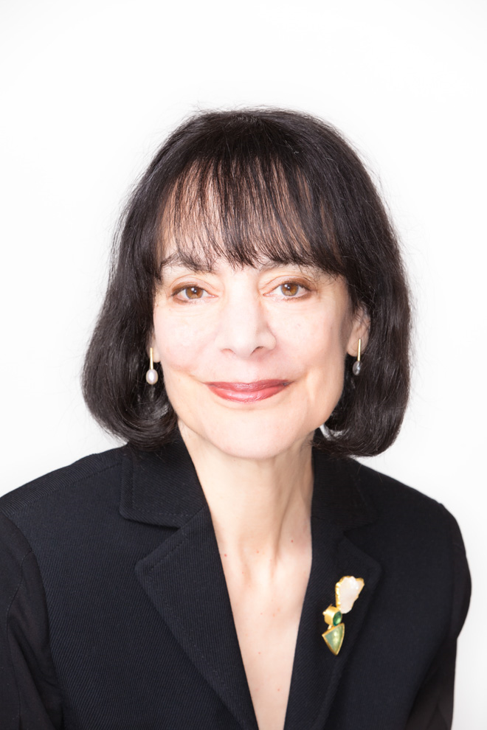
https://www.youtube.com/watch?v=KUWn_TJTrnU
Growth Mindset is an idea developed by
Carol Dweck

Slide 6
Characteristics of a fixed mindset
Ability and intelligence are innate
Intelligence and ability cannot be changed
Tend to give up easily with tasks
Avoid challenges
Feel threatened by the success of others
Ignore constructive criticism

Slide 7
Characteristics of a growth mindset
Intelligence can be developed over time through effort, dedication and hard work
Persevere with tasks
Enjoy challenges
Setbacks and criticism as lessons to be learnt from
Inspired by and learn from the success of others

Slide 8
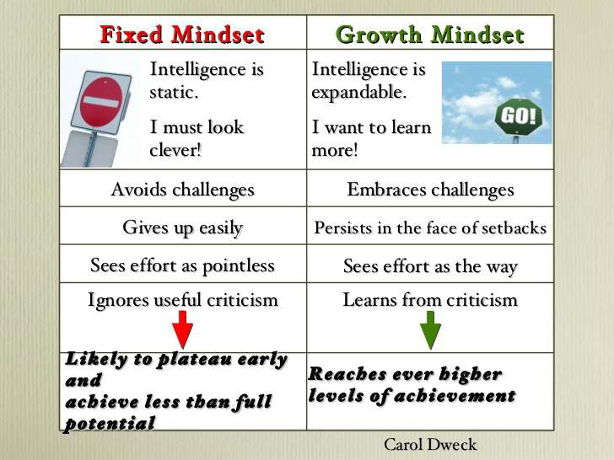

Slide 9
Likely groups with a ‘fixed mindset’
Research shows more girls have a fixed mindset than boys in maths
‘Higher attaining’ pupils often have a fixed mindset; having always received praise for being ‘clever’, they won’t take on further challenges for fear of losing that ‘clever’ label
‘Lower attaining’ pupils with a fixed mindset perceive themselves as ‘not smart’ and only ever capable of tackling ‘easy’ tasks
These children may see ‘failure’ as something to be avoided, so stay firmly in their comfort zone

Slide 10
Impact of praise on pupil attitude and achievement
Process Praise
Well done – you’re learning to ……
Good – it’s making you think – that’s how your brain is growing!
Every time you practise, you’re making the connections in your brain
stronger.
Remember, when things are difficult, that is when the best learning happens
Be brave. Have another go. Maybe this time you could …..
You’ve worked hard on this and you’ve succeeded because of x,y,z
(success criteria)
That’s a great mistake. Think about why it didn’t work and learn from it.
Our language tells children what we believe and what we value.

Slide 11
Be Careful
Children learn what they hear from their parents.
‘I can’t do maths’
‘I give up’
‘Your Granddad could never spell’
‘You’re so clever for getting it all right’
Don’t worry, you can’t be good at everything

Slide 12
Cognition
mental process acquiring knowing, understanding, and learning
Metacognition
The process of thinking about our own thinking and learning.
Motivation
our willingness to engage our metacognitive and cognitive skills and apply them to learning
https://youtu.be/8B3PnOjlgM0

Slide 14
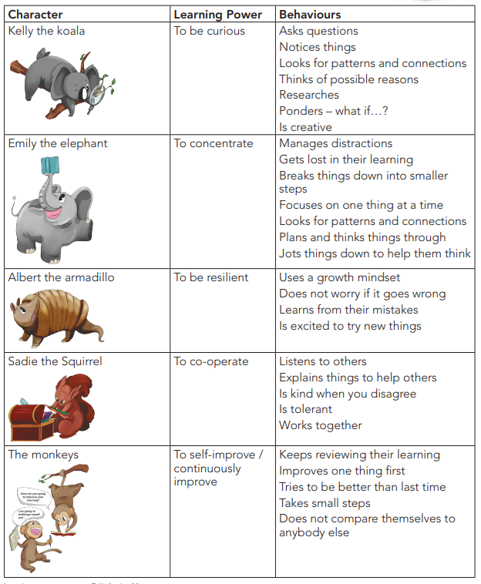

Slide 15
If parents want to give their children a gift, the best thing they can do is teach their children to love challenges, be intrigued by mistakes, enjoy effort, and keep on learning. That way their children don’t have to be slaves to praise. They will have a lifelong way to build and repair their own confidence.
Dr. Carol Dweck

